Slide 1
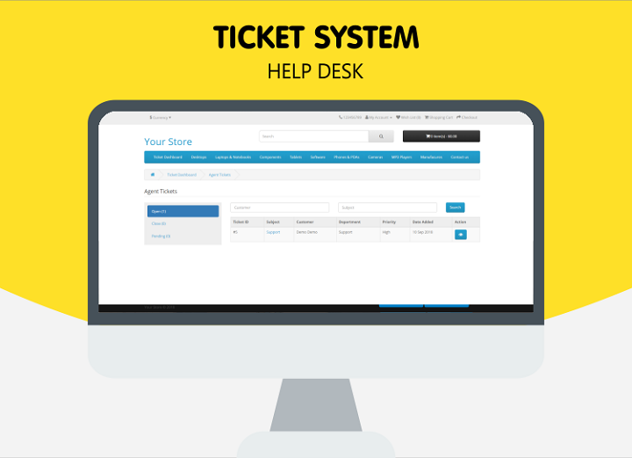
IT Ticket Analysis
Insights and Recommendations for Optimizing IT Support Operations
Ayushi Singh 16/01/2025

Slide 2
Introduction
Objective: Evaluate the IT support ticket management system to gain insights into operational performance and service quality.
Focus Areas:
Assess IT agent performance to identify high and low performers.
Analyze ticket resolution efficiency and employee satisfaction levels.
Evaluate overall team effectiveness and pinpoint improvement opportunities.
Goal: Provide actionable insights for informed decision-making on staffing (hiring, firing, and training) to optimize service quality and enhance team performance.

Slide 3
Objectives of Analysis
Understand ticket data and identify key trends.
Evaluate agent performance and customer satisfaction.
Provide actionable recommendations for process improvement.

Slide 4
Overview of Data
Attributes: 10 in Tickets table, 6 in IT Agents table, total 15 (Agent ID common).
Inconsistencies:
Misspellings in header & column values such as- Priority and Severity (e.g., Unassigned).

Slide 5
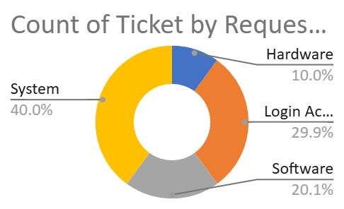
Ticket Trends
Average Daily Ticket Volume: 53.36.
Distribution by Category:
Hardware: 9,733
Login Access: 29,193
Software: 19,570
System: 39,002

Slide 6
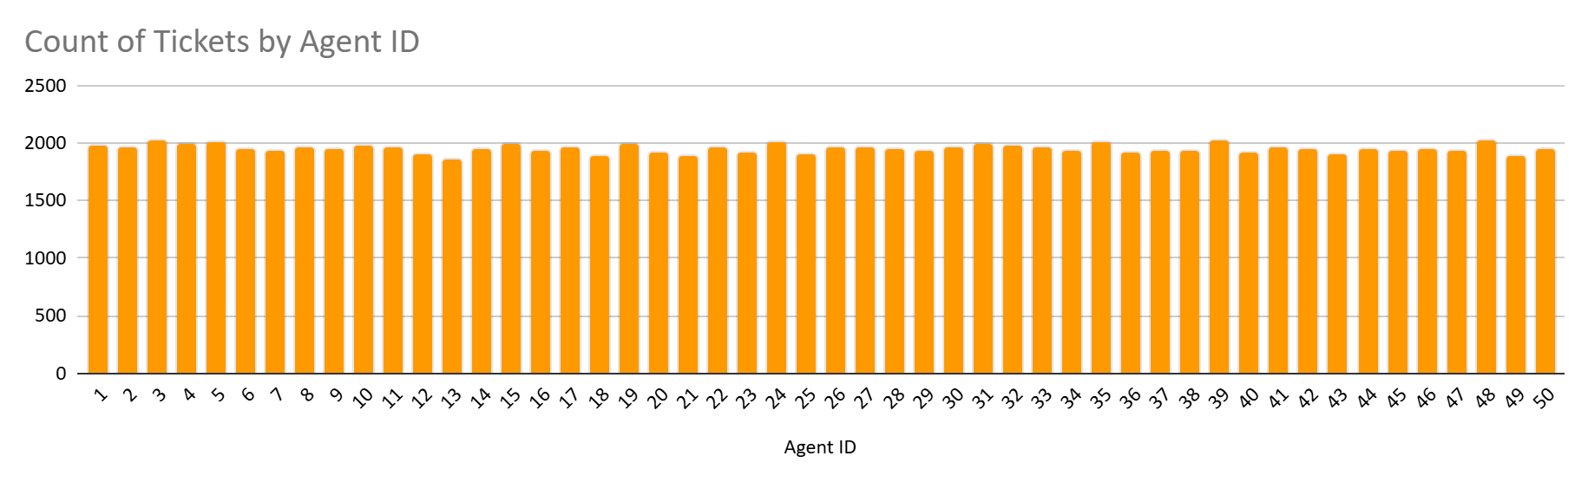
Agent Performance
Tickets Handled by Agents:
Agent with highest tickets: ID 39 (2,026 tickets).
Agent with lowest tickets: ID 13 (1,856 tickets).
Recommendation: Monitor workloads for fair distribution.

Slide 7
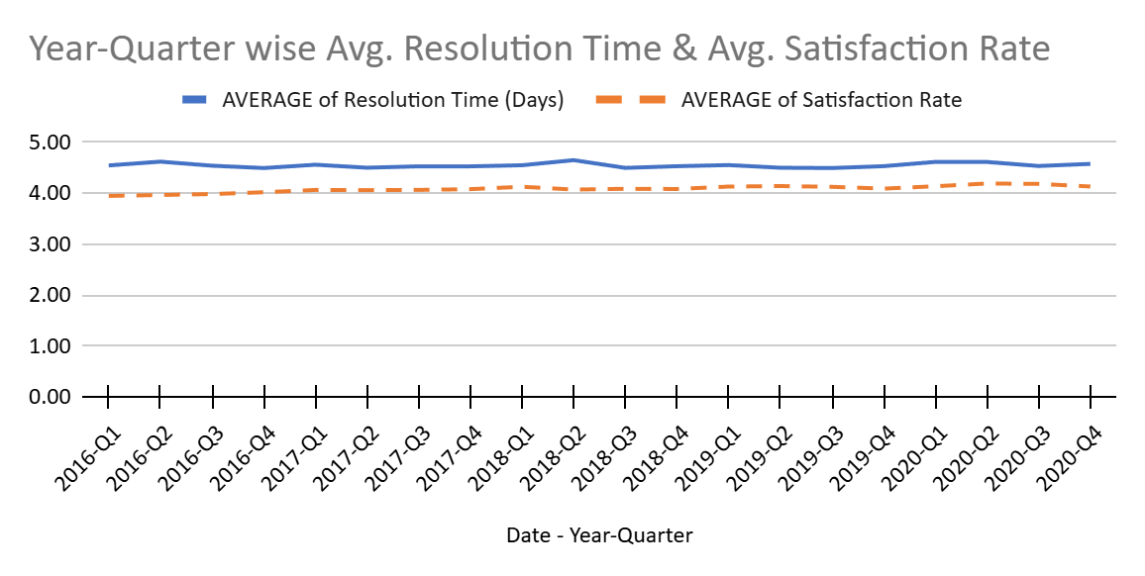
Resolution and Satisfaction Metrics
Average Resolution Time: 5 days.
Satisfaction Rate: Overall 4.10.
Correlation: Negligible (-0.04) between severity and resolution time.

Slide 8
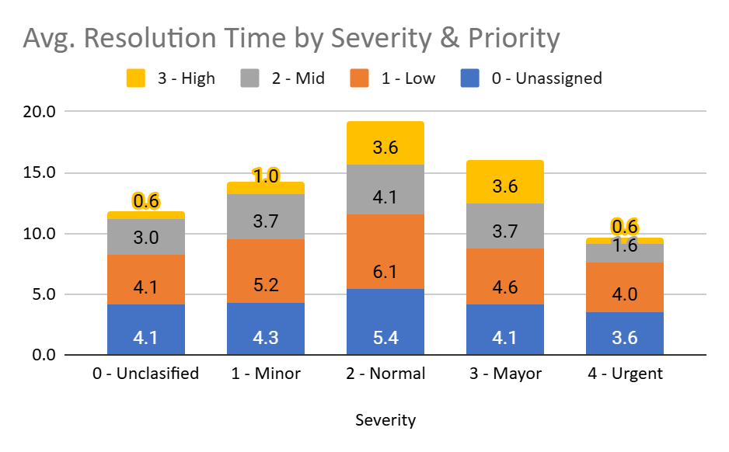
Priority and Severity Impact
Priority Analysis:
High priority: Faster resolution (3 days).
Low priority: Slower resolution (6 days).
Severity Analysis:
Urgent tickets resolved fastest (2 days).
Normal tickets dominate volume.

Slide 9
Investment Analysis
Options:
Hire more agents.
Improve training.
Upgrade ticket management software.
Insights:
Software upgrade improves efficiency across all ticket types.
Training addresses underperforming agents.
Recommendation: Prioritize software upgrade, followed by targeted training.

Slide 10
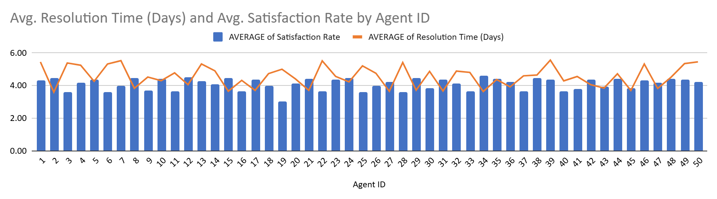
Agent Training Needs
Underperforming Agents:
Example: Agent ID 22 (lowest satisfaction and highest resolution time).
Recommendation: Provide tailored training for underperformers and monitor post-training improvement.

Slide 11
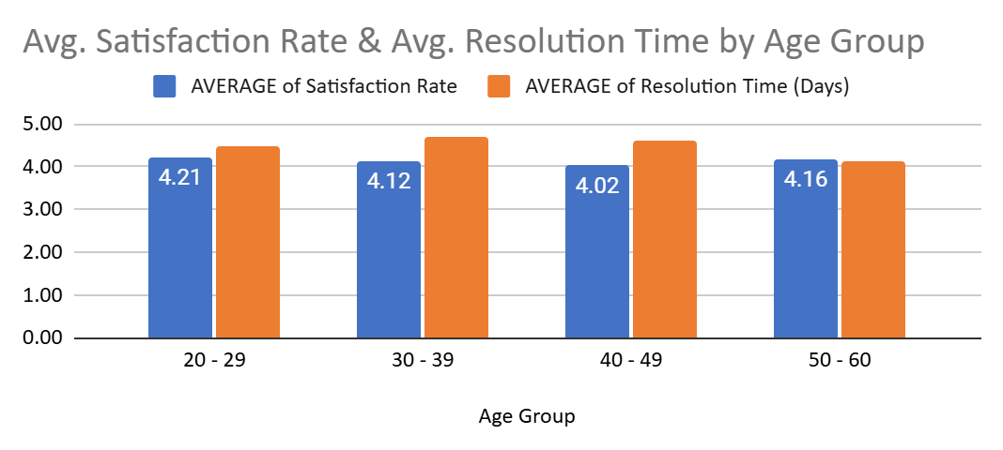
Demographics and Performance
Age Group Analysis:
Youngest group (20-29): Highest satisfaction (4.21).
Older groups (40-60): Stable resolution times but lower satisfaction.
Recommendation: Tailored support and mentorship programs.

Slide 12
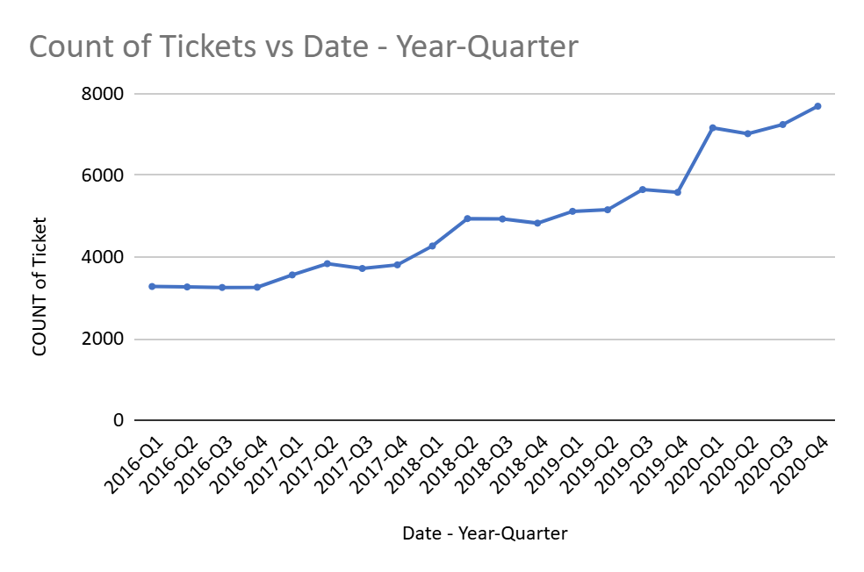
Trends in Ticket Volume and Satisfaction
Peak Ticket Volumes:
2020 (highest due to pandemic).
Stable Periods: Gradual growth from 2016-2019.
Recommendation: Plan for scalable resources during peak times.

Slide 13
Recommendations Summary
Technology Investment: Upgrade hardware/software for improved efficiency.
Training: Focus on underperforming agents.
Scalability: Prepare for peak periods with additional resources.
Metrics Monitoring: Continuously track key performance indicators.

Slide 14
Dashboard Metrics
Key Metrics:
Ticket volume by category and priority.
Average resolution time and satisfaction rate.
Agent performance metrics.
Trends by demographic and time.
For further reference attaching the snapshot of the dashboard in the next slide.

Slide 15
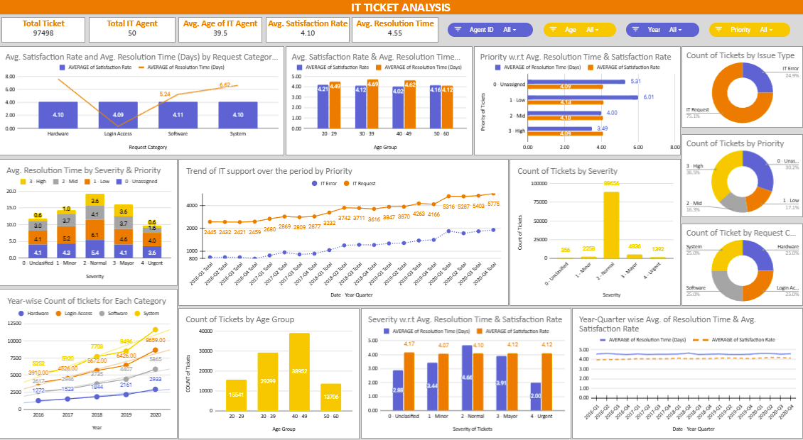

Slide 16

Conclusion
Summary:
Balanced investment in technology, training, and resources enhances efficiency.
Regular performance monitoring ensures sustained improvement.
Call to Action: Let’s prioritize and implement changes to optimize IT operations.

